Slide 1
A feature selection approach to increasing classification performance

Slide 2
Data Mining Stages
Data Collection
Data Preprocessing
Apply Data Mining Techniques
Interpret and Visualization

Slide 3
Data Mining Techniques
Association Rule Mining
Classification
Regression
Clustering

Slide 4
Data Preprocessing
Noisy and Missing values
Mislabeled
Imbalanced
High Dimensionality

Slide 5
High Dimensionality (Research Problem)
Drawbacks
Consumption of more memory Lower the classification performance Confuse the learning model
Solutions Apply Feature Selection or Feature Extraction Techniques

Slide 6
Existed Feature Selection Modes
Filter Based Based on the Information Theory Assigns the Rank to each feature Ex: Information Gain, Gain Ratio, Chi2, Symmetrical Uncertainty Wrapper Derives the Subset of Feature set Use the Searching Algorithm
Embedded

Slide 7
Research Objectives
To Study and analysis of different preprocessing techniques including imabalancing and high dimensionality.
To propose a feature selection methodology to address the high dimensionality issue using symmetrical uncertainity.
To propose a novel feature selection methodology to address the high dimensionality issue using correlation coefficient and symmetrical uncertainity.
To propose an unsupervised feature selection methodology to address the high dimensionality issue using clustering and filter based methods.
To evaluate proposed methods and compare with the existing methods using various classifiers

Slide 8
Proposed Methodology : 1
Based on correlation coefficient and Symmetrical Uncertainty
1. Find out the Symmetric Uncertainty (SU) value of each feature, such that all features will be in descending order of its SU value.
2. Choose the middle feature SU value as Threshold (T).
3. Generate the Correlation Coefficient Symmetrical matrix (CCE(Xi,Yi)) of initial data set .
4. Transform the above matrix to weighted binary matrix (WB) as per the below steps

Slide 9
Based on correlation coefficient and Symmetrical Uncertainty (Contd…)
for(i=1 to n)
for(j=1 to n)
if(CCE(Xi,Yi)>T)
WB(Xi,Yi)=1
else
WB(Xi,Yi)=0
End if
End for
End for

Slide 10
Based on correlation coefficient and Symmetrical Uncertainty (Contd…)
5. Calculate the total weight of each feature W(F) as per below steps.
for(i=1 to n)
for(j=1 to n)
W(Fi)= WB(Xi,Yi)
End
End

Slide 11
Based on correlation coefficient and Symmetrical Uncertainty (Contd…)
6. Group the features which are having same weight(W(F))
Clusteri={Fi1, Fi2,...Fik} /* i is the cluster id, increment i by 1 until all features are formed */
7. Choose the best feature (feature which has maximum SU value) from each cluster and form the final candidate subset

Slide 12
Based on correlation coefficient and Symmetrical Uncertainty (Contd…)
for(i=1 to last cluster)
Fi= MAX SU(cluster i)
Candidate Feature set (CFS)<- Fi
End

Slide 13
Example
Assume there are ten features (a, b, c, d, e, f, g, h ,i, j) in a sample data set . SU value of each feature is given in below Table.1

Slide 14
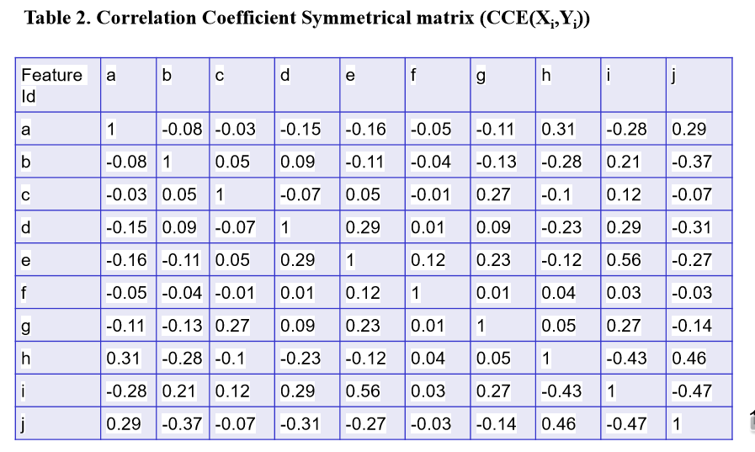

Slide 15
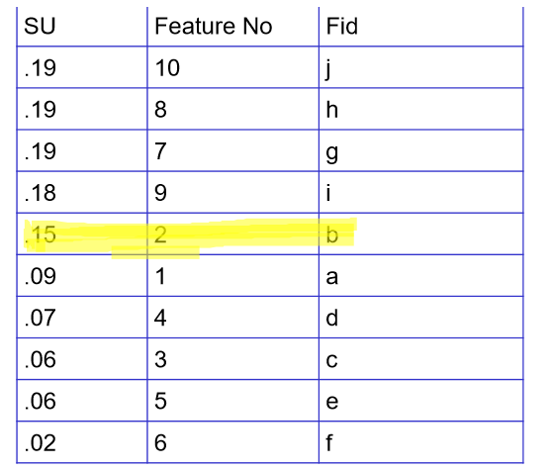

Slide 16
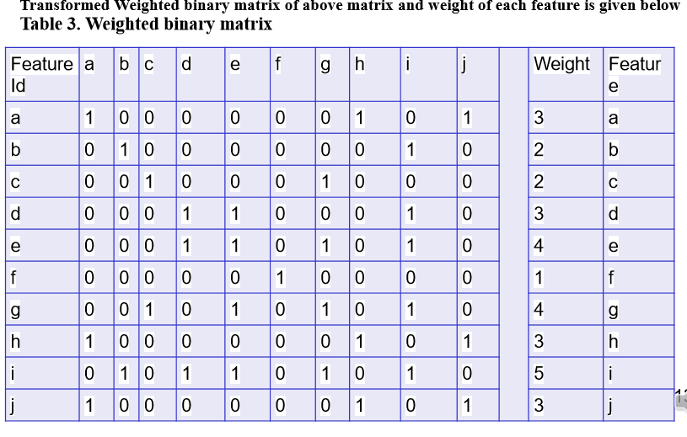

Slide 17
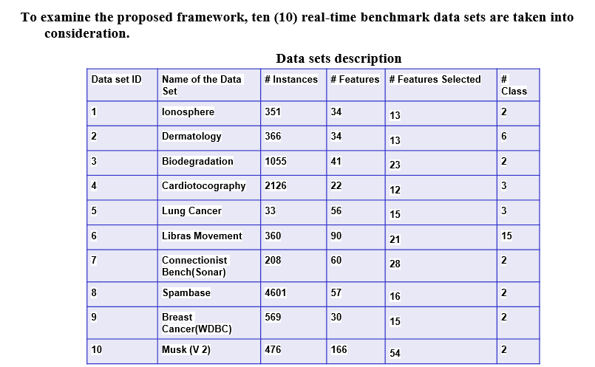

Slide 18
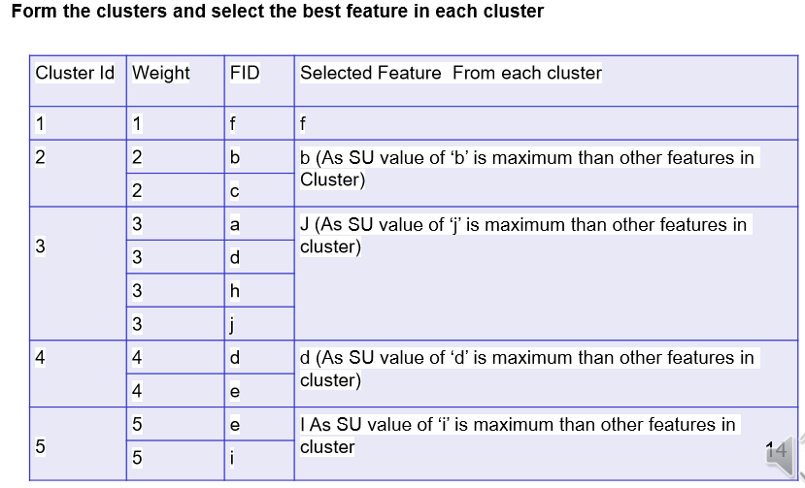

Slide 19
